Slide 1



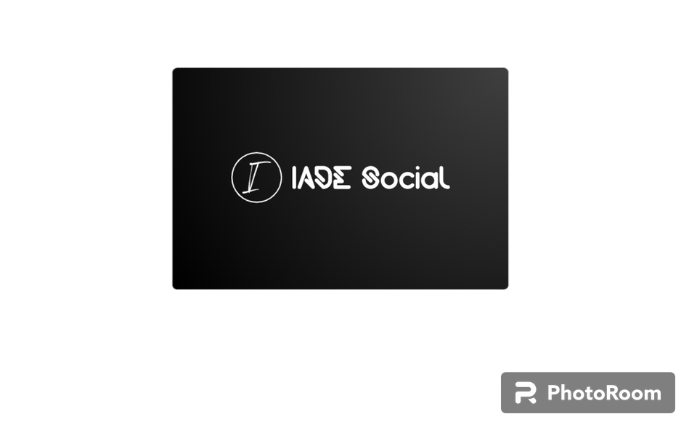

Iade Social
IADE SOCIAL
PRESENTATION
Presented by Group 5

Slide 2



Iade Social
FACTS
ABOUT US
we are an app designed to fulfil the students of IADE social needs, providing news and informations about the academic life and even what to eat daily. Focus is make comunnication happen and enyojable.

Slide 3




Iade Social
SOFTWARE APP
DOWNLOAD
Download the app and communicate with others students see in real time what they are doind and what news they got to share with you...
New Member
Bug Reports
+1.346
-3.58%

Slide 4

Iade Social
APPLICATION
USER
The more users more features we are gonna realise to promote comunication among students and social events
Grow Reporting
+3.000
/user

Slide 5




Iade Social
PROFESSIONAL
TEAM
Aricarlo
Edson
Programmers and partners
Programmers and partners
Our professional team is ready to understand the needs of a student and make a health social enviromnt to all users
Kelvin
Programmers and partners

Slide 6


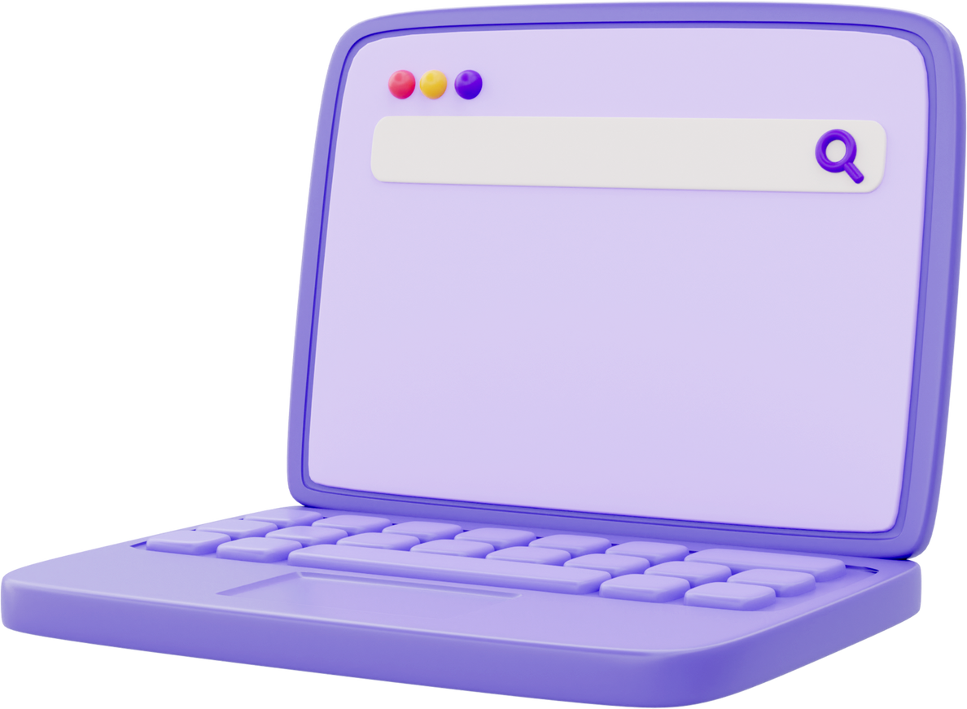
Iade Social
IADE_SOCIAL: CENTRALIZED ACADEMIC PLATFORM.
IADE Social is a platform dedicated to IADE students, focused on centralizing academic life communication.
Stay up to date with student association announcements, participate in events, and share information on the public wall. An essential tool to connect and inform all students.

Slide 7


Iade Social
IS FRIENDLY
IADE SOCIAL is a friendly app you can follow the people that posts your favourite content and like or save.
User Apps
+4.000

Slide 8



Iade Social
OUR LATEST
UPDATES
Update your app and get all the features you need to post your content on the platform, be aware that we are going to realise updates evry month.

Slide 9



Iade Social
GET IN TOUCH
WITH US
We are 100% avaliable to clarify any doubt about the app. In case you need to report a situation don't hesitate to contact us.
21 393 9690
Lisbon, Santos

